Slide 1
Referee Scheduling System
Gurukiran 3BR23EC048
Mohammad Ithesham 3BR23EC099
Shanmuka 3BR23EC151
Siddeshwar Pujeri 3BR23EC155
Manish 3BR23EC171

Slide 2
Introduction
Introduction to Referee Scheduling System
In various sports, the effective allocation of referees is crucial for maintaining the integrity and smooth operation of games. A Referee Scheduling System is designed to streamline this process, ensuring that each game has the appropriate number of qualified referees while considering their availability, preferences, and any necessary qualifications

Slide 3
Domain
Purpose: The main goal is to automate and optimize the scheduling of referees for matches, reducing manual errors and administrative workload.
Referees: Individuals who officiate the games, requiring proper scheduling based on availability and skill level
Availability Conflicts: Referees may have multiple commitments, making it challenging to find suitable times
User Interface: Intuitive platforms for referees and administrators to input availability, preferences, and view schedules.
Database Management: To store referee profiles, schedules, and match details.

Slide 4
Objectivies
Automate Scheduling Processes:
Reduce manual workload by automating the assignment of referees to matches based on predefined criteria.
Optimize Referee Allocation:
Ensure that referees are matched to games considering their availability, skill level, and geographic location, maximizing efficiency.
Enhance Communication:
Facilitate clear and timely communication between referees, sports organizations, and teams through notifications and reminders.
Maintain Fairness and Consistency:
Assign referees in a manner that upholds the integrity of the sport, ensuring qualified referees officiate appropriate matches.
Improve Flexibility and Adaptability:
Allow for quick adjustments in scheduling to accommodate changes, such as cancellations or last-minute availability of referees.

Slide 5
Algorithm
Initialize Data Structures
Sort Matches:
Iterate Through Matches:
Output Schedule
Notify Referees
Feedback and Adjustment

Slide 6
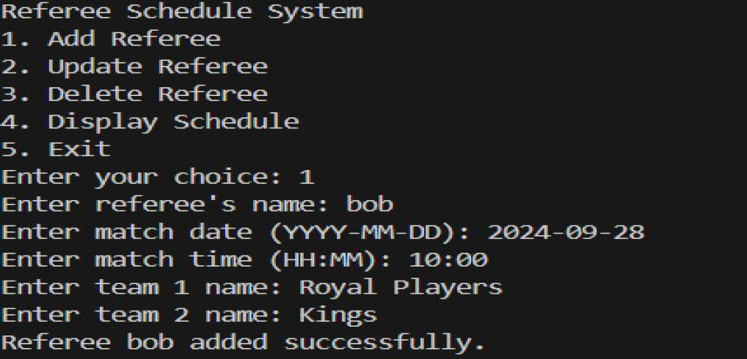
Result

Slide 7
Future Enhancement
Machine Learning Models: Implement algorithms that analyze past schedules, referee preferences, and availability to optimize assignments
Conflict Resolution: Automatically detect and resolve scheduling conflicts based on referee availability, location, and skill level.
Mobile App Integration: Develop a mobile app that allows referees to easily check their schedules, accept or decline assignments, and communicate with organizers.
Customizable Dashboards: Allow users to customize their dashboards to see relevant information at a glance.

Slide 8
Conclusion
The Referee Scheduling System algorithm offers a structured and efficient approach to assigning referees to matches, addressing the complexities of availability, qualifications, and geographic constraints. By automating the scheduling process, this system minimizes administrative workload, enhances fairness, and ensures that qualified referees are assigned to appropriate games.

Slide 9
Thank You

